Slide 1

Average Mortality Rates
A data analysis of the 10 most populous countries and their average Adult mortality rates based on various societal factors

Slide 2
Contributors
Caleb Wolf
Kyle Burks
Chavell Scott
Simone de Oliveira Allen

Slide 3
Proposal:
To analyze the relationship of different health and societal
factors across the world's largest countries with mortality rates
to see which has the strongest potential impact.
Measurements to analyze:
Sex
Percent of population overweight
Physicians per 1000 people
Population size.

Slide 4
Our Hypotheses:
Females have a lower mortality rate than males
Obesity is strongly positively correlated with mortality rate
Physicians per 1,000 citizens is strongly negatively correlated with mortality rate
Larger nations have higher mortality rates.

Slide 5
Lessons Learned: Data Cleaning
Issue:
The data was missing as not all countries gathered all the data we were interested in each year.
Solution:
Collecting average rates from 2006-2015 instead and comparing those for each country.

Slide 6
Lessons Learned: Data Cleaning
Issue:
The data was not rotated the way we wanted for dataframes to run analysis on. The desired columns were listed in rows.
Solution:
Creating sub-dataframes and combining them to make sure it was rotated correctly before beginning analysis.

Slide 7
10 Most Populous Countries
China
India
United States
Indonesia
Brazil
Pakistan
Nigeria
Bangladesh
Russian Federation
Mexico

Slide 8
Section 1: Big-Picture Analysis

Slide 9
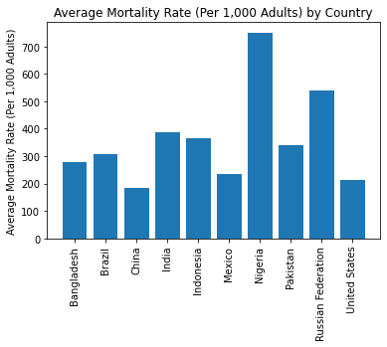
Average Mortality Rate By Country
Notes:
Findings:
- Nigeria and the Russian Federation had significantly larger mortality rates than the other 8 countries, beating the next highest by over 300 and 100 deaths per 1,000 adults, respectively.
Further Analysis:
- Further analysis could be done to determine if there were any significant events/diseases between 2006 and 2015 in these countries that could explain this significant difference.
- One potential explanation for Russia would be the war in Ukraine in 2014.

Slide 10
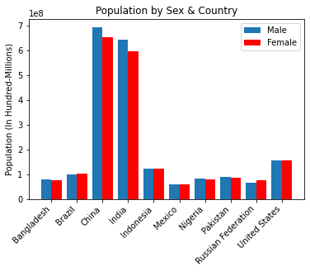
Distribution of Sex by Country
Notes:
Findings:
- It looks as if populations are relatively evenly distributed between males and females except in India and China.
Further Analysis:
- It would be interesting to look into reasons why there is a higher male population in these two countries during these years.

Slide 11
Section 2: Mortality Rate and Sex
Notes:
Statistical Analysis Findings:
- The average total mortality rate (Per 1,000 Adults) across all countries is 360.2, the average female mortality rate (Per 1,000 Adults) was 143.5 and the average male mortality rate (Per 1,000 Adults) was 216.6. This tells us that on average, the male mortality rate is higher than the female mortality rate across these countries.
-However, the high standard of error measurements received with this data imply that the data may be strongly varied or include outliers.
- The average total population across these countries was 408,166,400 (408 hundred-million), with an average female population of 200,103,900 (200 hundred-million) and an average male population of 208,062,500 (208 hundred-million). This tells us that on average, these countries have a higher male population than female.
- However, the high standard of error measurements imply that the data may be strongly varied or include outliers.

Slide 12
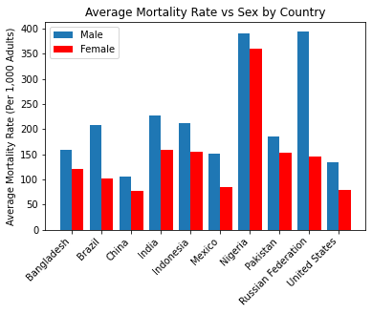
Average Mortality Rate By Country
Notes:
Findings:
- Overall, the country Nigeria stands out with the highest mortality regardless of gender.
- In the Russian Federation during these years, the male mortality rate was MUCH higher than the female, indicating something may have happened during this decade that resulted in more male than female loss of life.
- As per our earlier findings, male mortality rates are consistently higher across the countries in our analysis.
Further Analysis:
- It would be interesting to look into what may have in the Russian Federation to result in these very different male vs female mortality rates.
- As said before, this is perhaps it is due to the first war in Ukraine in 2014.

Slide 13
Section 3: Mortality Rate and Population
Notes:
Statistical Analysis Findings:
- The average total mortality rate (Per 1,000 Adults) across all countries is 360.2, the average total population was 408,166,400 (408 hundred-million), the average urban population was 197,774,300 (197.7 hundred-million), and the average rural population was 210,392,100 (210.4 hundred-million). This tells us that across these 10 nations, they have a higher average rural population than urban.
- However, the high standard of error measurements imply that the data may be strongly varied or include outliers..

Slide 14
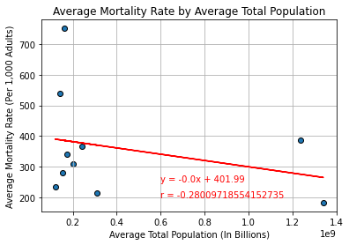
Average Mortality Rate by Average Total Population
Notes:
Findings:
- With an r-value of less than -.3, there is likely little to no correlation between average mortality rate and average total population for our dataset. However, the lack of data between .4 and 1.2 billion citizens may be hiding a bell curve distribution. Sadly, as these are the 10 largest nations, we lack any datapoints in that range.
Further Analysis:
- Further analysis could be done by adding more nations or a random selection of nations to see if there is something about this dataset that makes it abnormal. However, as data is missing for a number of smaller countries, such analysis may run into its own issues.

Slide 15
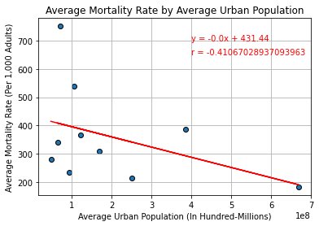
Average Mortality Rate by Average Urban Population
Notes:
Findings:
- With an r-value between -.3 and -.4 there is some correlation between average mortality rate and average urban population. However, the lack of data between 4 and 6 hundred-million citizens may be having an effect on our findings.
Further Analysis:
- Further analysis could be done by once again adding more or randomly selected nations.

Slide 16
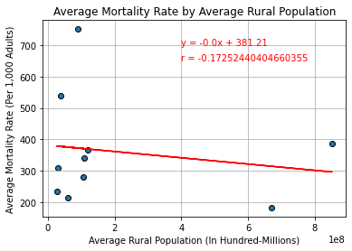
Average Mortality Rate by Average Rural Population
Notes:
Findings:
- With an r-value of less than -.3, there is likely little to no correlation between average mortality rate and average rural population. However, the lack of data between 2 and 6 hundred-million citizens may be having an effect on our findings.
Further Analysis:
- Further analysis could be done by once again adding more or randomly selected nations.

Slide 17
Section 4: Mortality Rate and Number of Physicians
Notes:
Statistical Analysis Findings:
- The average Physicians (per 1,000 people) across all countries is 1.442502. The low standard error measurement tells us that this dataset may not be diverse enough for accurate analysis.

Slide 18
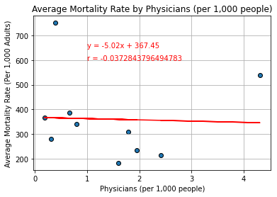
Average Mortality Rate by Physicians Per 1,000 People
Notes:
Findings:
- With an r-value of less than -.3, there is likely little to no correlation between average mortality rate and rate of physicians (per 1,000 people). However, with more points on the graph, it is possible a stronger connection may emerge.
Further Analysis:
- Further analysis could be done by once again adding more or randomly selected nations.

Slide 19
Section 5: Mortality Rate and Percent Overweight
Notes:
Statistical Analysis Findings:
- The average Prevalence of overweight (% of adults) across all countries is %38.65. However, the high standard error measurement may imply that the prevalence is quite diverse and not similar across all nations.
- The average Prevalence of overweight, female (% of female adults) is 39.83 and the average Prevalence of overweight, male (% of male adults) is %37.55, but once again, with the high standards of error, these are likely varied across the nations studied.

Slide 20
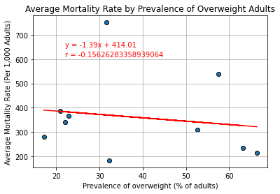
Average Mortality Rate by Overweight Adults
Notes:
Findings:
- With an r-value of less than -.3, there is likely little to no correlation between average mortality rate and Prevalence of Overweight Adults.
Further Analysis:
- Further analysis could be done by once again adding more or randomly selected nations.

Slide 21
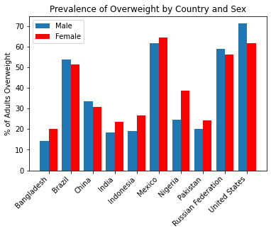
Citizens Overweight by Sex and Country
Notes:
Findings- There did not seem to be a strong leaning one way or the other in terms of a certain sex being more overweight across these nations. 60% had higher female rates and 40% had higher male rates, with the US having the highest overall rate.

Slide 22
Lessons Learned: Interpreting Plots
Issue:
In the sections "Plot Average Mortality Rate by Female Average Mortality Rate (Per 1,000 Female Adults)" and "Plot Average Mortality Rate by Male Average Mortality Rate (Per 1,000 Male Adults)" we were unable to determine what the data was telling us beyond that as more males or females died, overall deaths in a nation went up, which is to be expected.
Solution:
Removing charts from our analysis.

Slide 23
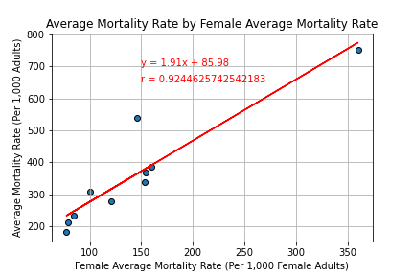
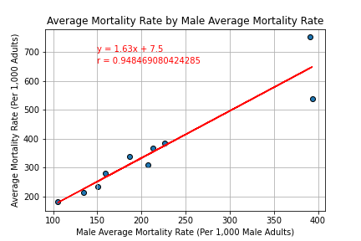
Removed Charts:

Slide 24
Conclusion:
Females have a lower mortality rate than males
Finding - True
Obesity is strongly correlated with mortality rate
Finding - False
Physicians per 1,000 citizens is strongly negatively correlated with mortality rate
Finding - False
Larger nations have higher mortality rates.
Finding - False
Notes:
Findings:
- Our dataset was limited to the 10 largest countries in the world. We did this because they were likely to have the data needed to run our analysis, but our findings indicate that out of the factors analyzed, only sex and rural population had an impact on mortality rate in these nations, with the urban population size only being slightly correlated.
- This is interesting, as it seems like factors that we would expect to have a strong correlation with mortality rate worldwide, like % of population overweight or physicians per 1,000 people do not impact these nations as much, possibly because of something they all share in common (selection bias). If so, this could be found via further analysis on a random selection of countries or adding more countries to the list, but the difficulty would be finding countries with the data needed to run this analysis.

